Slide 1
Me, Myself, and Why
Identity as the starting point for civic leadership
Who am I, and how do I want to show up for others?

Slide 2

Our Starting Point
Leadership appears in everyday choices.
It shows in how we listen, include others, respond, and follow through.
Today, you will choose one quality you want to practice.
This Photo by Unknown Author is licensed under CC BY-SA
Notes:
Say: 'Over the next several weeks, you will build skills that help you speak up, work with others, and improve something in your school or

Slide 3
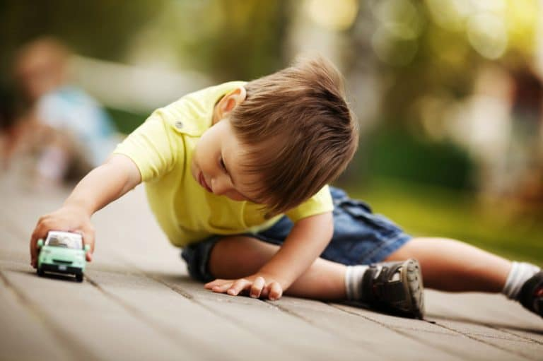
What makes you you?
Think of a toy or game that you loved when you were very little.
What was the toy?
Why was it special?
How did it make you feel?
How did it make you who you are today?
This Photo by Unknown Author is licensed under CC BY-NC-ND
Notes:
Give students 30 seconds of quiet think time. Then have every student share with a partner or trio. Invite two or three brief whole-group examples.

Slide 4
What our favorite toys or games tell us about who we are.
Play is one of the first ways we form our identity..
What we choose to play with shows us what matters to us.
Your “toy” may be a symbol of your
Your “toy” may be a symbol of your
Adventure
Creativity
Comfort
Connection
Competition
Feeling capable
Something else?
Notes:
'The reason you loved that object may reveal something you cared about before you had words for it.' Ask students which word, if any, connects to their object. Accept their own words too.

Slide 5

Three Views of Me – What do we “believe” about who we are.
Take a moment to think about:
Three words from someone who knows and understands me
Three words from someone who sometimes misunderstands me
Three words I want people to use about me
Notes:
Pause for about 30 seconds after each prompt. Students may write privately. Then invite them to compare one response with a partner. They never need to name the person who misunderstands them.

Slide 6
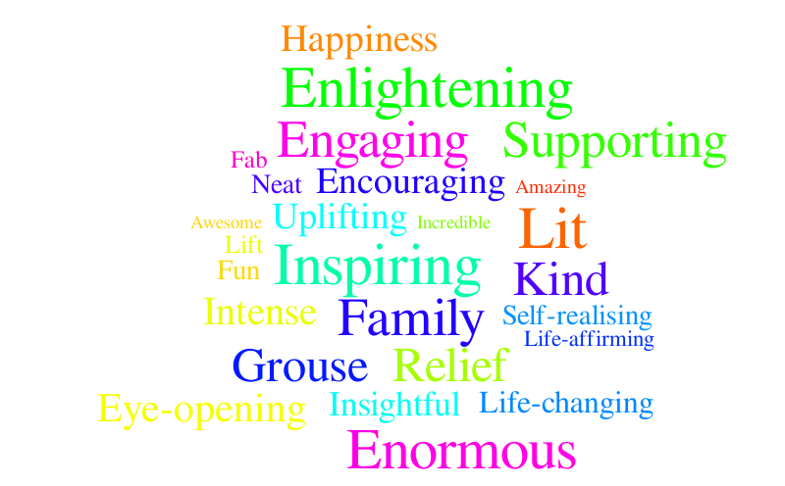
What Do You Notice?
Which words appear more than once?
Where is there a difference?
Which description feels most true?
Which quality do you want to strengthen?
Notes:
Invite volunteers to share one comparison, not their entire list. Offer an honest, age-appropriate example if students need a model. Remind them that another person's perception gives information, but it does not define them.

Slide 7

Building my leadership
During this program, I will practice being __________
by __________.
Notes:
Ask each student to select one quality they want to be known for and name a visible action. Example: 'I will practice being dependable by completing the job my group assigns me.'

Slide 8

Identity Becomes Leadership
How do we become civic leaders?
Identity: knowing what matters to me
Leadership: choosing how I will act
Civic leadership: using who I am to contribute with and for others
Notes:
Close by asking one or two students to name the quality they chose. Collect or save students' statements for later team roles and project reflection.

Slide 9

Closing questions
What are 3 things about yourself you want to share with someone after you leave here?
What are two ways you hope you will help others by being a leader?
What is one thing you really liked about learning about you?

