Slide 1
Who am I really and
Who Are My People?
The People, Places, and Everyday Details That Shape Us

Slide 2

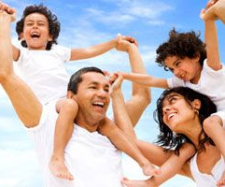
Who Am I really?
We are shaped by the people, places, and experiences in our life.
Looking at the people in our lives helps us know ourselves and it helps others know us
This Photo by Unknown Author is licensed under CC BY-SA

Slide 3
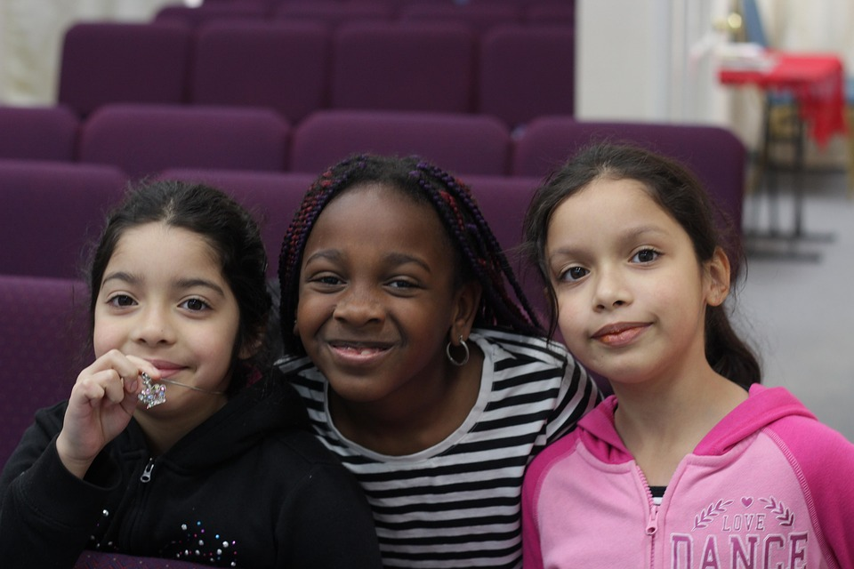
People Who Shape Us
Family and chosen family
Friends and neighbors
Teachers, coaches, and mentors
Teams, clubs, cultural groups, and faith communities
Who has helped shape you?
Notes:
Keep the meaning of 'my people' broad. Give students 30 seconds to picture two or three people. Students may keep their choices private.

Slide 4
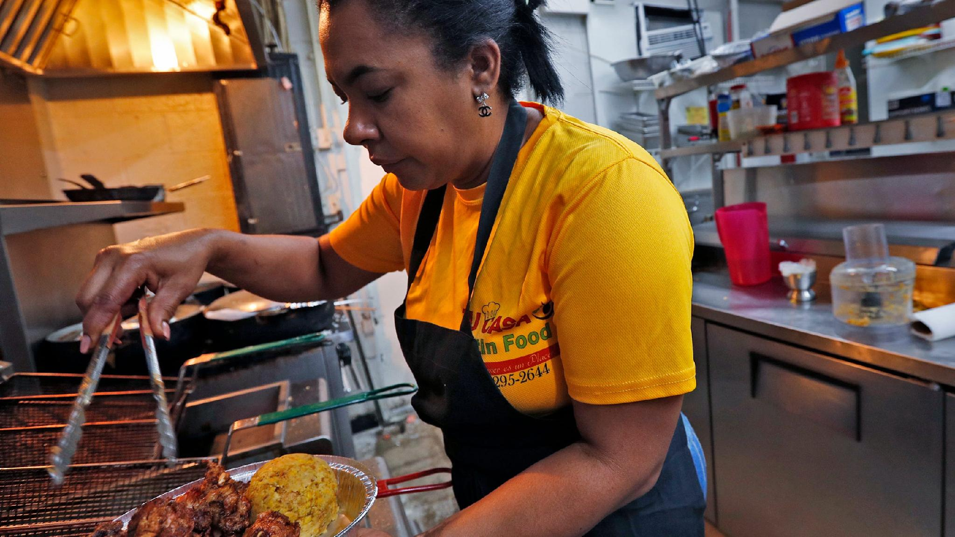
One Small Detail
Choose one person.
What do they say, cook, play, teach, do, or believe?
Share one detail with a partner.
Notes:
Model a specific detail from your own life. Encourage details such as a repeated saying, a food, a routine, a song, or an act of care. Students may pass.

Slide 5


Who are my people?
Sometimes, poems, song lyrics, raps, or stories help us to get in touch with who we REALLY are and what our lives have been like and what we dream of becoming.

Slide 6
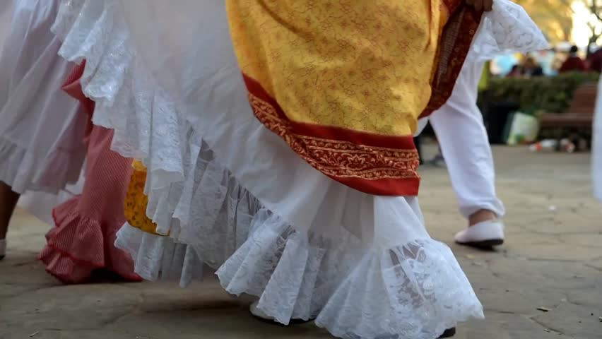
Listen for a Life in the Details
As you listen to the three poems, notice:
objects and places
people and phrases
foods, sounds, and traditions
memories and beliefs

Slide 7
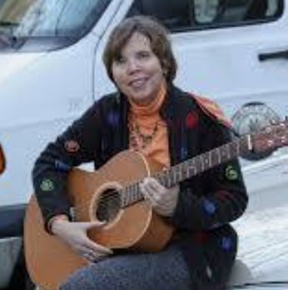
Where I'm From by George Ella Lyon
I am from clothespins, from Clorox and carbon-tetrachloride. I am from the dirt under the back porch. (Black, glistening, it tasted like beets.) I am from the forsythia bush the Dutch elm whose long-gone limbs I remember as if they were my own. I'm from fudge and eyeglasses, from Imogene and Alafair. I'm from the know-it-alls and the pass-it-ons, from Perk up! and Pipe down! I'm from He restoreth my soul with a cottonball lamb and ten verses I can say myself. I'm from Artemus and Billie's Branch, fried corn and strong coffee. From the finger my grandfather lost to the auger, the eye my father shut to keep his sight. Under my bed was a dress box spilling old photographs, a slit of light was all they needed to tell me my family's story.
Notes:
This needs to be in the student guide. Along with the other two poems. Put the pictures in as well.

Slide 8
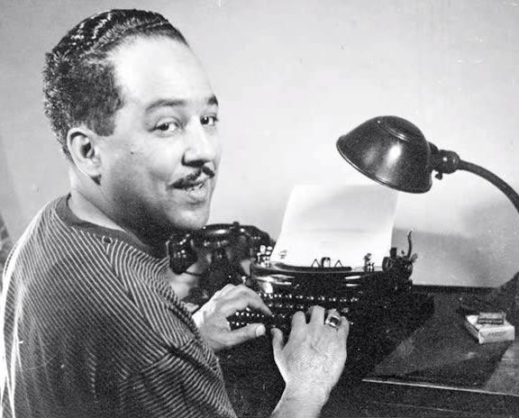
"I, Too” – by Langston Hughes
I, too, sing America. I am the darker brother. They send me to eat in the kitchen When company comes, But I laugh, And eat well, And grow strong. Tomorrow, I'll be at the table When company comes. Nobody'll dare Say to me, 'Eat in the kitchen,' Then. Besides, They'll see how beautiful I am And be ashamed— I, too, am America.

Slide 9
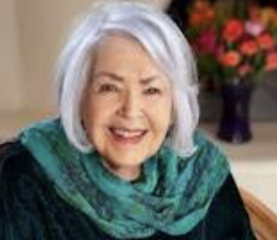
Legal Alien – by Pat Mora
I am…Bi-lingual, Bi-cultural,
able to slip from "How's life?"
to "Me'stan volviendo loca,"
able to sit in a paneled office
drafting memos in smooth English,
able to order in fluent Spanish
at a Mexican restaurant,
American but hyphenated,
viewed by Anglos as perhaps exotic,
perhaps inferior, definitely different,
viewed by Mexicans as alien,
(their eyes say, "You may speak
Spanish but you're not like me")
an American to Mexicans
a Mexican to Americans
a handy token
sliding back and forth
between the fringes of both worlds
by smiling
by masking the discomfort
of being pre-judged
Bi-laterally.

Slide 10
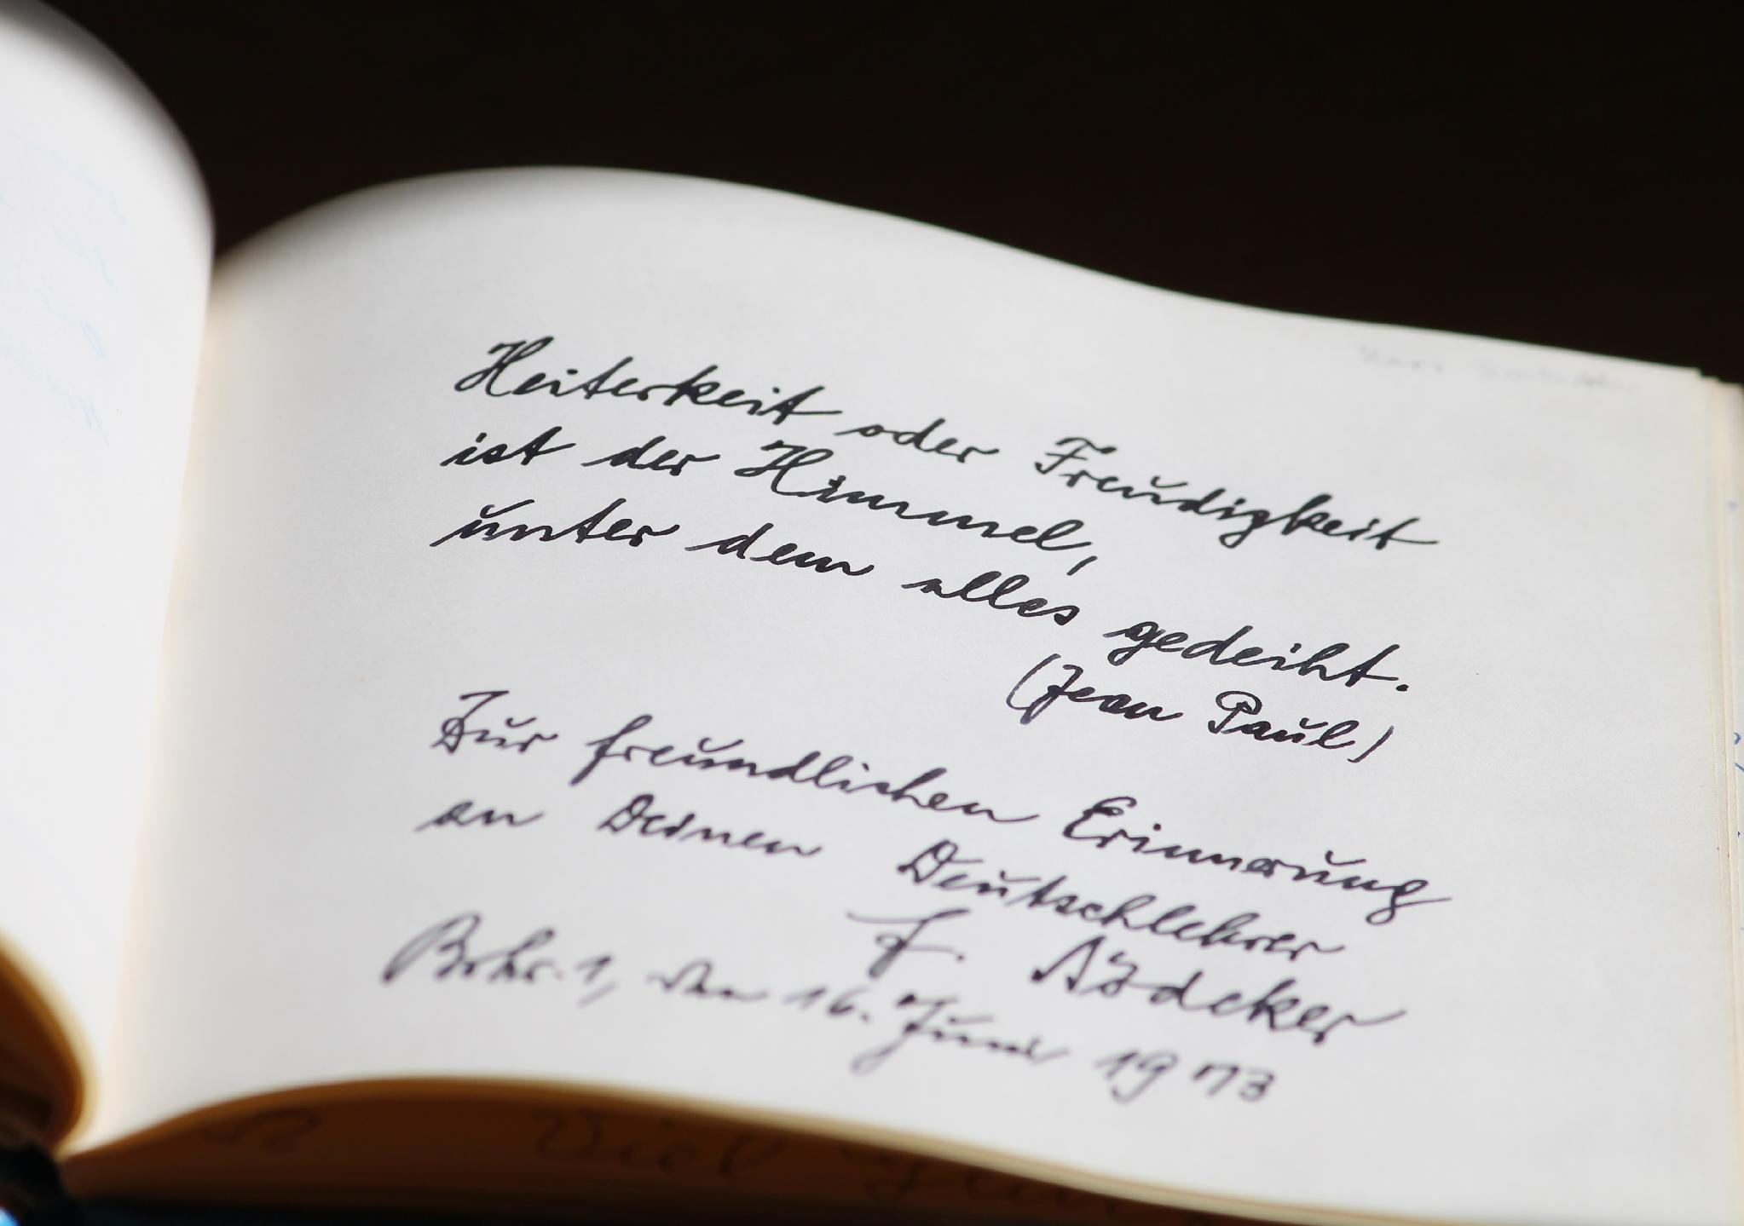
What Did You Notice?
Which poem did you think was meaningful for you?
Which detail helped you picture the speaker's world?
What might that detail suggest?
How can a small detail communicate something important?
Notes:
Invite two or three observations. Keep the discussion open. Students do not need to identify one correct interpretation.

Slide 11
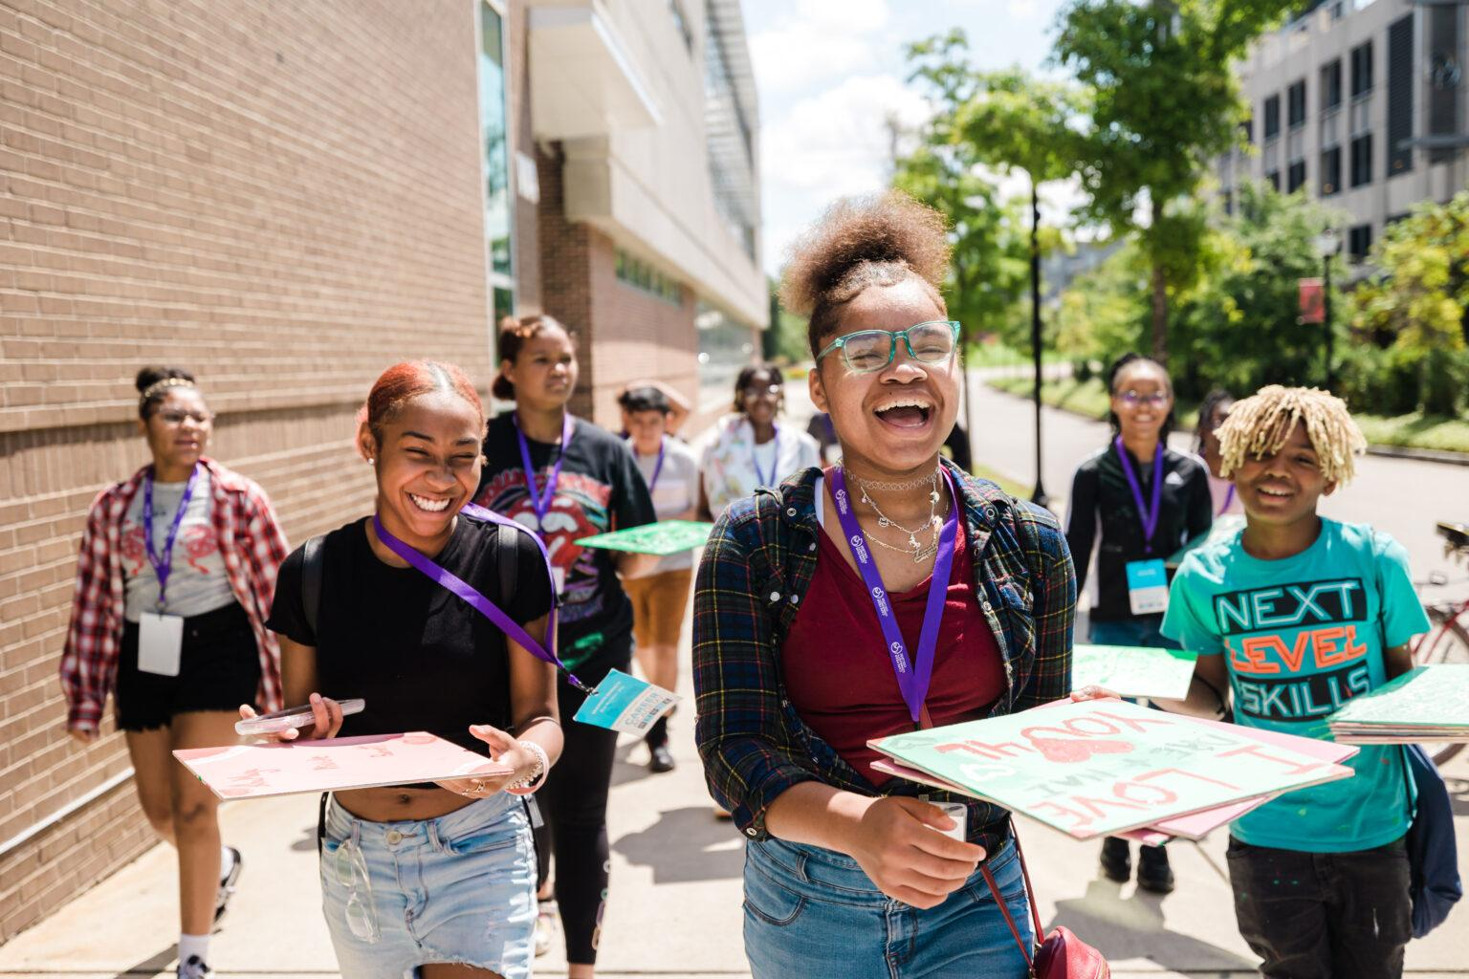
Gather Your Details
Think about your life and start writing down
An object you remember
A place where you felt known, safe, challenged, or free
A food, smell, song, sound, or tradition
A phrase someone often says
A person, story, belief, name, or hope you carry

Slide 12

Create Your Own 'Where I'm From'
Create your own Where I’m From as anything you choose - a poem, song, rap, or drawing.
Use details that feel true to you.
You do not need to explain every reference.
Possible beginning: 'I am from __________.'
This Photo by Unknown Author is licensed under CC BY-SA-NC

Slide 13

What I Carry Into Leadership
Share one line, image, or detail, or choose to pass.
What strength, responsibility, or hope comes from your people?
Who might you want to show up for through your civic project?
Notes:
Use pairs or trios for voluntary sharing. Close by explaining that the people and places that shape us can also shape whom we notice, serve, and include. Save the work for later project planning.

Slide 14

Closing summary
What is one thing from your “Where I’m From” that you want to share with someone?
What part of this experience meant the most to you?

