Slide 1
My Place, My Purpose
From Belonging and Noticing to an Action Research Question
Learning Experience 3
DePaul University

Slide 2
My Place, My Purpose
To become a true civic leader, we are deepen what we know about ourselves by finding what matters most to us.
We will look at belonging and decide as a civic leader, when belonging isn’t present, what do we want to do.
Where do I belong?
Where is belonging harder?
What do I care about enough to investigate?
Notes:
Tell students that this learning experience begins the move from personal reflection to civic action research. They need curiosity today, not a finished solution.

Slide 3
What is True Belonging?

Slide 4
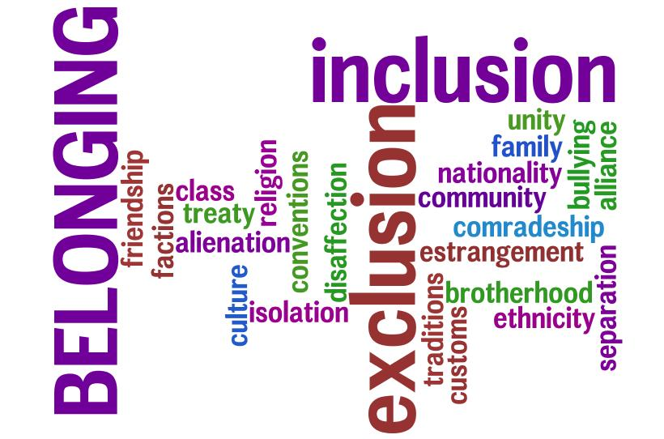
Belonging
What do you think belonging feels like?
Is belonging the same for everyone?
Have you always known when someone felt like they didn’t belong?
Notes:
Ask kids to respond and then move to next slide

Slide 5
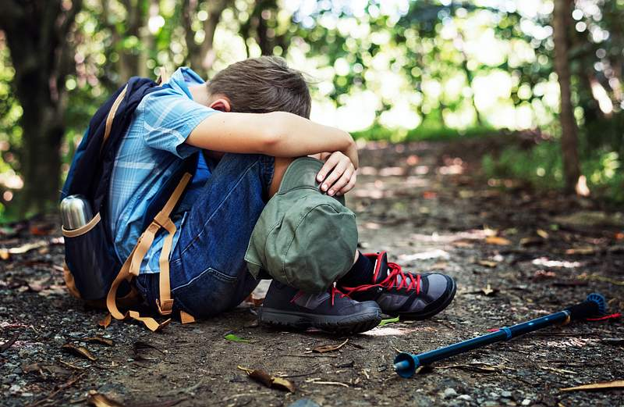
When We Feel We Don’t Belong
Have you ever felt:
Left out or not welcome.
Like no one understood you or wanted to understand you.
Like you were different than everyone else.
Almost everyone has felt they don’t belong.
It’s important not to ignore the feelings of not belonging.
Notes:
Tina shares story

Slide 6
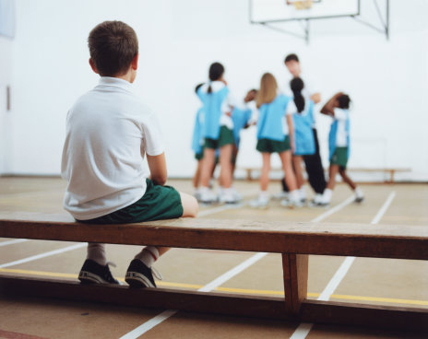
Your Belonging Journey
Think about places where you spend time: classrooms, lunch areas, teams, clubs faith communities, neighborhoods, online spaces, home
Where can you relax and be yourself?
Where do people notice when you are missing?

Slide 7
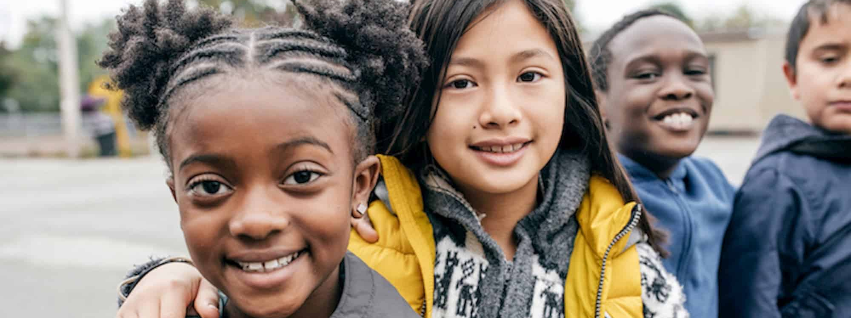
Belonging Has Clues
Complete: 'I feel like I belong here when __________.'
What makes belonging possible for me in that place?

Slide 8

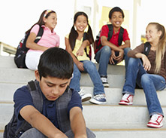
Look Again From Another View
Think of that same situation…
Who seems like they may feel they don’t belong?
What have you actually noticed?
What are you assuming?
What are you still wondering?
Notes:
Clarify that students cannot decide how another person feels. Ask them to examine visible patterns, routines, access, and opportunities to participate

Slide 9

Observation, Assumption, or Solution?
Observation: 'The same five students answer most questions.'
Assumption: 'Everyone else is lazy.'
Proposed solution: 'We need a new participation rule.'
Inquiry question: 'What makes it easier or harder for students to participate?'
What is another solution?

Slide 10

What Makes Belonging Easier or Harder?
List what helps people belong, feel welcome, or be heard.
List what creates an unwelcoming or exclusionary situation.
What is one pattern that bothers you, interests you, or makes you want to learn more.
Why does it matter to you?

Slide 11
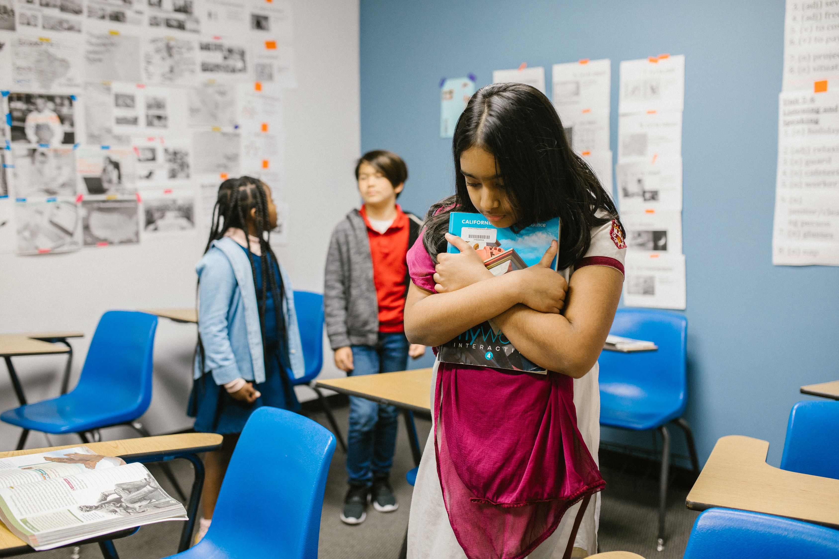
Where in your daily life do you know people who may feel they don’t belong?
Can the situation be changed?
Can others help?
Have you ever tried to help?

Slide 12
Build your Action Research Idea
Think about places you want to make better and answer these prompts.
I care about __________ because __________.
I have noticed __________.
I need to hear from or learn more about __________.
A question worth investigating is __________.
This is just the very start of thinking about your action research.

Slide 13
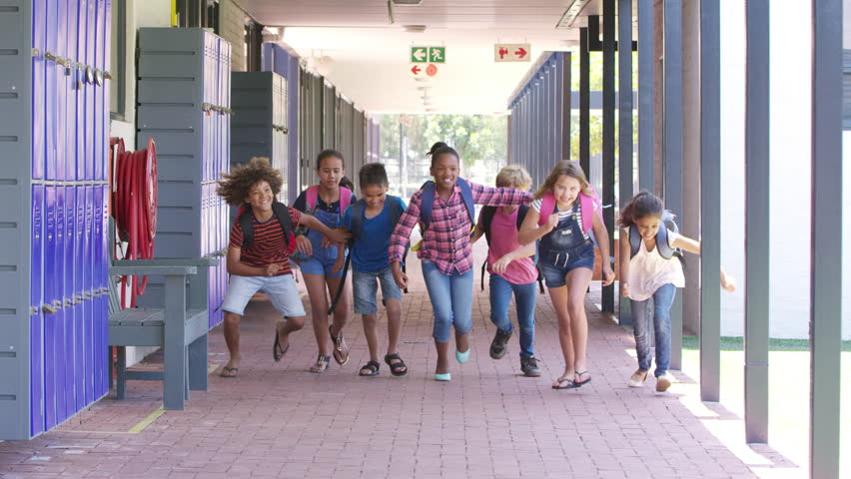
Closing
What do you think would help more people to feel belonging, acceptance, and care from others?
What would help you feel more belonging, acceptance, and care from others?

