Slide 1
What Matters Most
Using Values When Priorities Compete
Learning Experience 4

Slide 2

How do we know what matters most?
Civic leaders often face choices among worthwhile priorities.
Their goal is responsible reasoning, not one correct answer.
In this experience, we will learn how to:
Using values to make thoughtful choices when priorities compete
How will I decide when more than one good thing matters?

Slide 3

What are values and how do they guide our civic leadership?
Values are ideas we want to live by.
They become visible through our actions.
They matter most when a choice feels difficult.
Notes:
Ask for one example of a value students have seen someone demonstrate through action. If needed, model respect through listening or responsibility through following through.

Slide 4
Choose What Matters to You
Look at the Values Listing you have in the worksheet.
Circle 8 values that are important to you.
Narrow it down to 5
Narrow that down to 3 values
Belonging, Compassion, Courage, Creativity, Fairness
Faith, Family, Freedom, Friendship, Fun
Honesty, Justice, Kindness, Learning, Loyalty
Respect, Responsibility, Safety, Service, Success
Notes:
Clarify unfamiliar words without promoting particular choices. Remind students to choose values that feel personally meaningful, not answers they think adults want.

Slide 5

Make Each Value Concrete
For each of your three values, complete:
I chose __________ because __________.
This value looks like __________.
This value is hardest to live when __________.
Notes:
Circulate and ask, 'What would someone see you doing if you lived that value?' Invite partners to share one example from their own life or someone they admire.

Slide 6
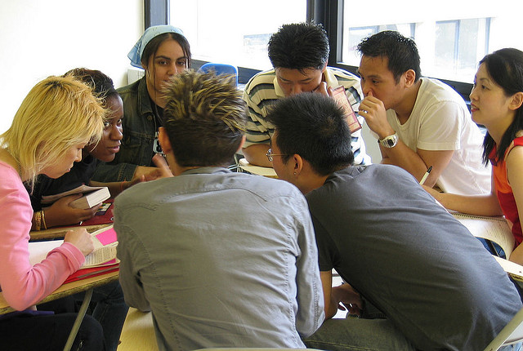
Try using your values
Your student leadership group has $1,000 for one project. There are 4 projects that the school needs.
a quiet lunch space
new sports and recess equipment
a community celebration
an emergency-supplies closet
You cannot fully fund more than one. What should the group choose?
Notes:
Read the scenario. Assign groups of three or four. Make clear that each option meets a real need, so groups must explain the tradeoffs in their decision.

Slide 7
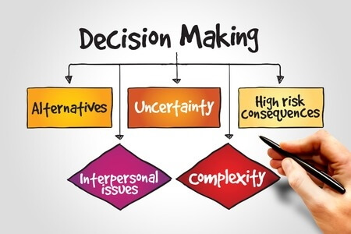
A Four-Part Decision Process
PAUSE: What makes the choice difficult?
NAME: Which values or priorities compete?
WEIGH: Who benefits? Who may be affected or have to wait?
CHOOSE: What will we do, and which values support it?
Notes:
Give groups time to work through all four questions. Watch whose voices guide the decision. Prompt groups to make room for disagreement and invite anyone who has not spoken.

Slide 8

Explain your group’s decision
Our group chose __________.
The strongest conflict was between __________ and __________.
We prioritized __________ because __________.
One cost or limitation of our choice is __________.

Slide 9

My Decision Compass
All strong civic leaders have their very own “decision compass” that guides them.
Create your compass by answering:
Three values I want to guide me are __________.
When good priorities compete, I will pause and ask __________.
I will consider who may be helped, who may be affected, and __________.
I want people to experience me as __________.

Slide 10

Closing
What is one thing you learned about making difficult decisions?
What value of yours is the easiest to live by?
How can you use what you have learned?

