Slide 1
The Me I am Becoming
A Personal Vision for How I Want to Live, Lead, and Make an Impact
Learning Experience 5
DePaul University

Slide 2
The Me I Am Becoming
Successful civic leaders know what matters most and know how they want to help others.
Civic leaders create a “vision” or goal for their leadership.
A vision is NOT a career path, or forever. A vision is where you think you want to lead right now.
Today, you will create
A personal vision for how you want to live, lead, and make an impact
Look at who you are becoming, and what part of the world could become better because you showed up and helped?
Notes:
Explain that a vision names a direction. Students do not need to predict their future or select a career.

Slide 3

Look Back for Clues
To create your vision, look back on your life for clues.
Something I know about myself is __________.
Someone or something that shaped me is __________.
A value I want guiding me is __________.
A strength, interest, or gift I want to use more is __________.
Notes:
Have students review earlier work if available. Ask them to star two clues they want to carry into their vision.

Slide 4

Imagine “You” One Year From Now
Someone says, 'You have really grown this year.'
What would they have seen you do as a civic leader?
How would people feel around you since you are leading?
What in the school, community, or somewhere else, might be better because you took action to do something?
Notes:
Give students two quiet minutes to write or sketch. Keep the focus on actions, relationships, and impact rather than awards, popularity, possessions, or jobs.

Slide 5
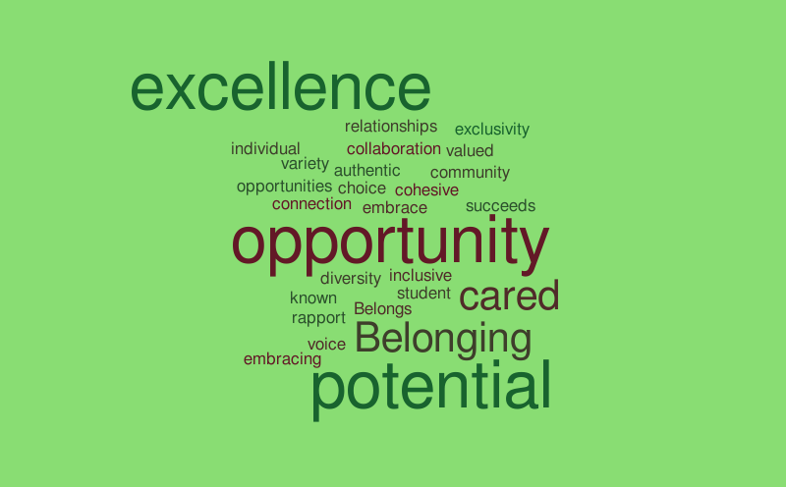
What does a good “vision statement” look like?
It sounds like you.
It says how you want to act as a civic leader.
It points toward a goal you care about and want to improve.
It is short enough to remember.
It leaves room for you to grow.
Notes:
Ask students which quality will keep the vision from sounding like a slogan. Emphasize honest, specific language.

Slide 6

Sample Middle School Civic Leader Vision Statement
I want to be someone who helps little kids so that they can have fun and play rather than be on screens.
I will use my value of caring to lead ways to help kids play.
I can begin by talking to other students like me who want to help little kids.

Slide 7

Build Your Vision
Complete the following for you…
I want to be someone who __________ so that __________.
I will use my __________ to __________.
I can begin by __________.
Notes:
Give students time to draft in words, images, or both. Encourage them to connect a personal strength to a specific way of contributing.

Slide 8
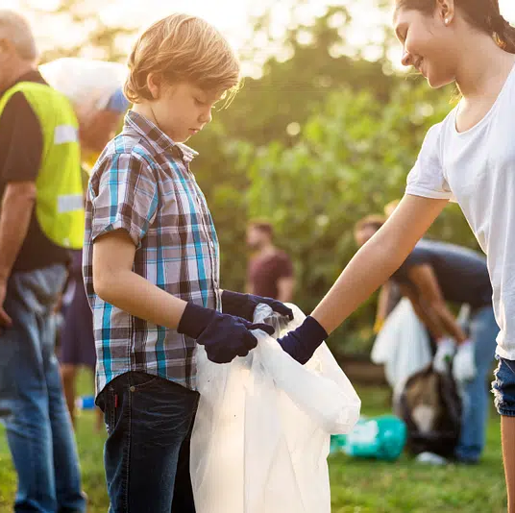
Make Your Impact Specific
Replace a vague phrase:
'help people' - Who? How?
'be successful' - What would success look like?
'make a difference' - What would become better?
Notes:
Coach with questions instead of rewriting the student's voice. Ask, 'Who do you hope to support?' 'What might someone see you doing?' or 'Why does that matter to you?'

Slide 9

Hear What a Partner Hears
Read your vision or let your partner read it silently.
Partner response:
'I hear that you care about __________.'
'I can picture you __________.'
'I wonder if you want to say more about __________.'
Notes:
Keep feedback descriptive. Partners do not score, correct, or rewrite another student's vision. Writers decide whether any suggestion helps.

Slide 10
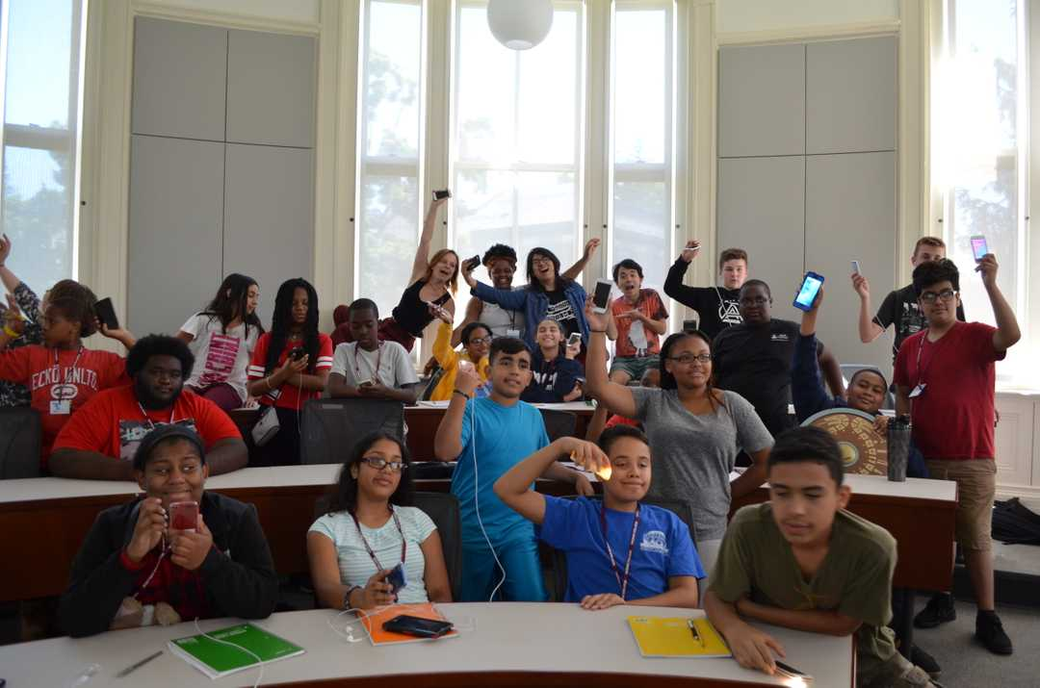
One Step This Week
What is one action you can take in the next week?
My action: __________
When or where I will try it: __________
How this connects to my action research project: __________
Notes:
Help students choose an action within their control. Close by explaining that the action research project gives them a place to practice their vision by listening, learning, choosing responsibly, and working toward a change they care about.

Slide 11

Closing
Who can you share your vision with today?
How can you use what you have learned about your vision?

